Slide 1
For a Greener Tomorrow

Slide 2
Amwaj Beach Club Sustainability activities
For a greener tomorrow

Slide 3
Our Commitments to Stakeholders
Employee Well-being
Community Engagement
Environmental Responsibility
Materiality Assessment

Slide 4
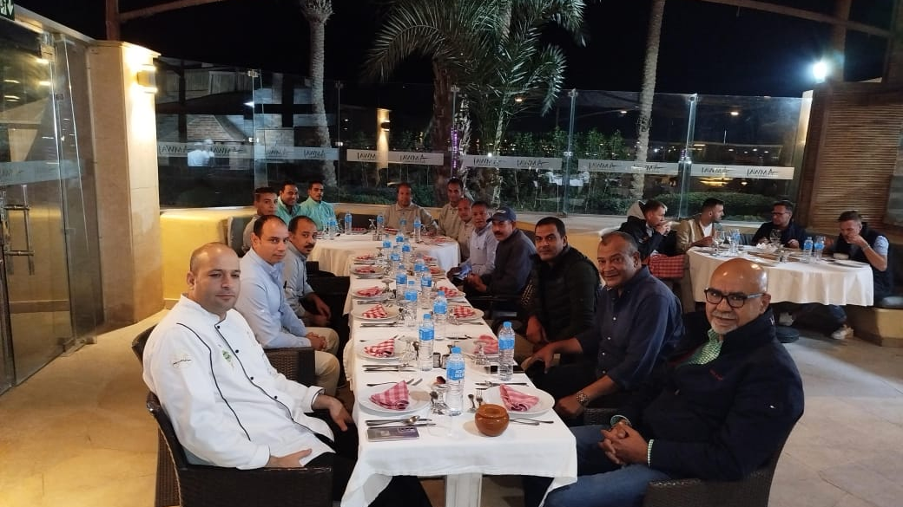
Caring for our people

Slide 5
Fun day for school of children with special needs in Amwaj Beach Club
Caring for our community

Slide 6
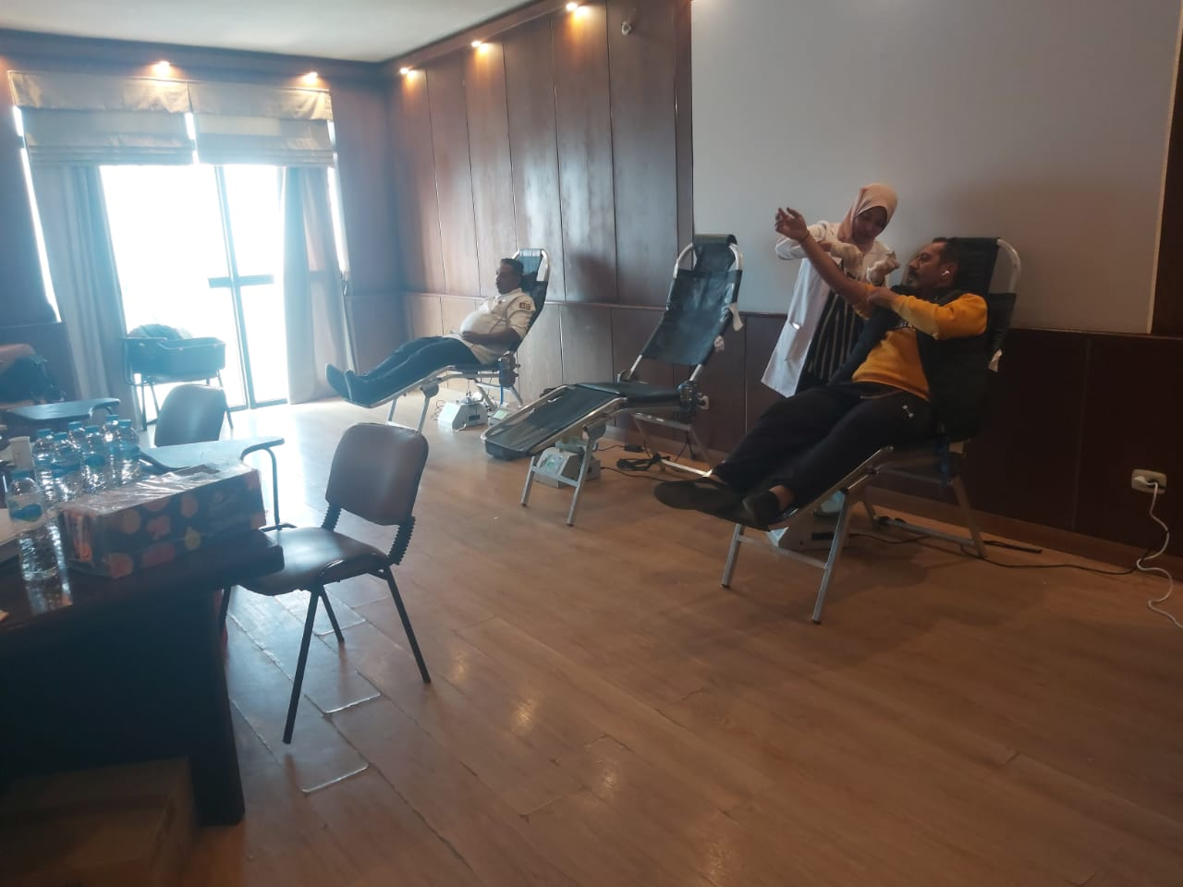
Community Engagement: We actively support and invest in the local community, working together to create a sustainable and thriving environment.
Blood donation initiative

Slide 7
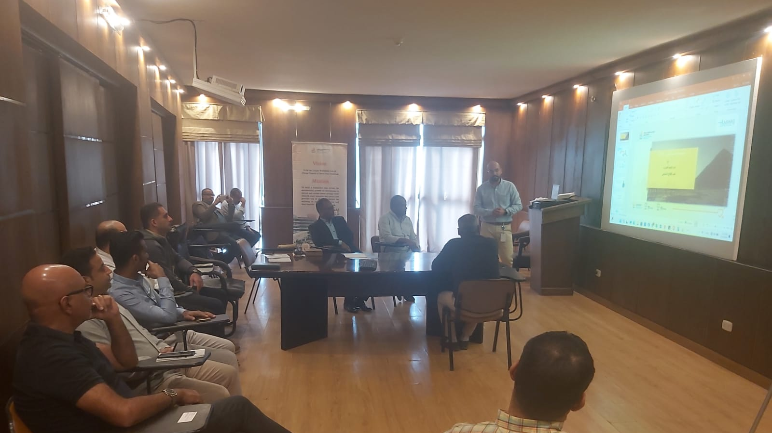
57357 Cancer Hospital support
Community Engagement

Slide 8
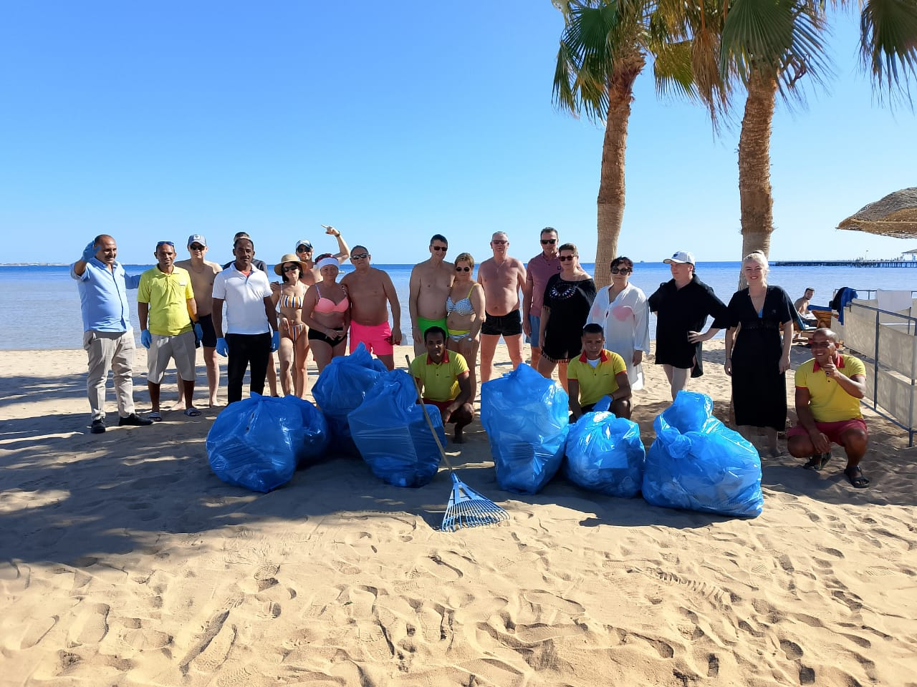
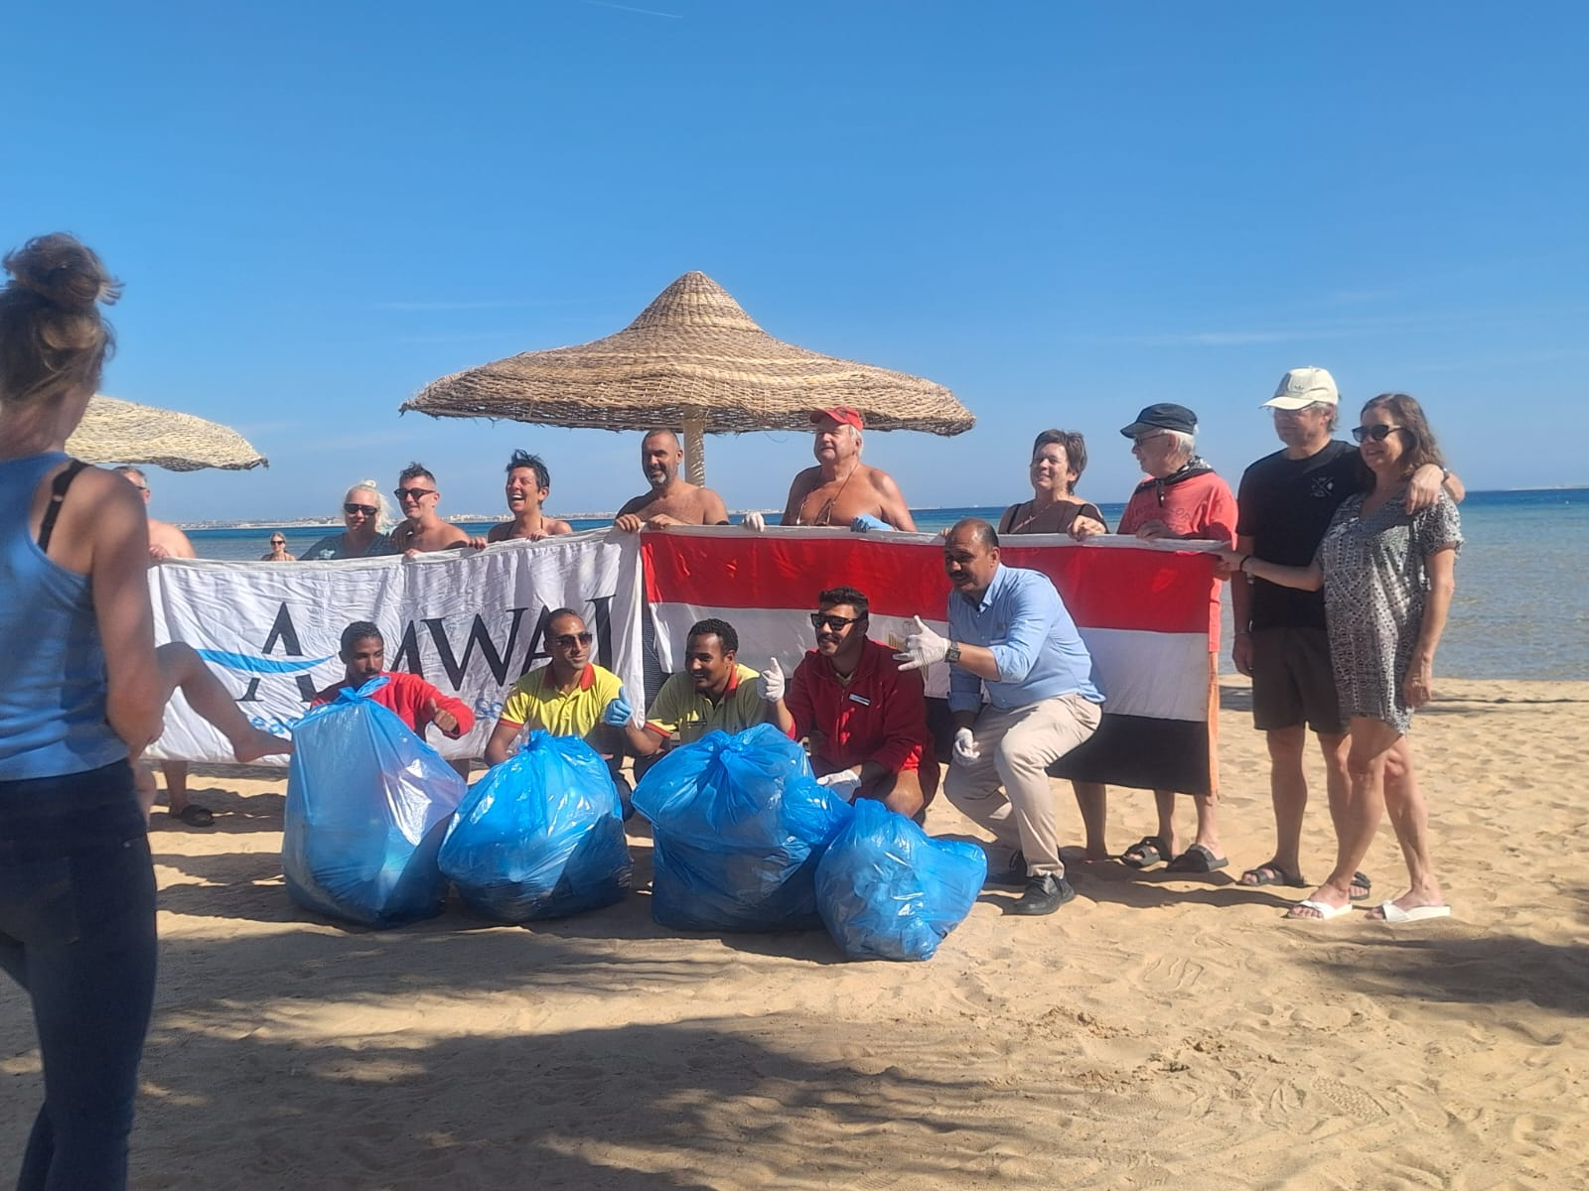
Regular beach cleaning activities
Beach and coral cleaning

Slide 9
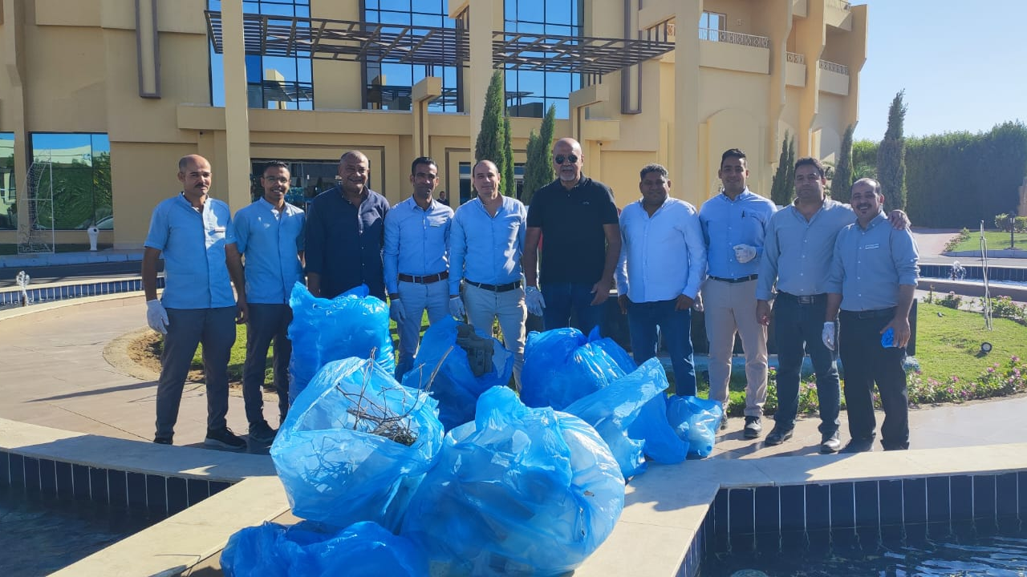
Clean up day

Slide 10
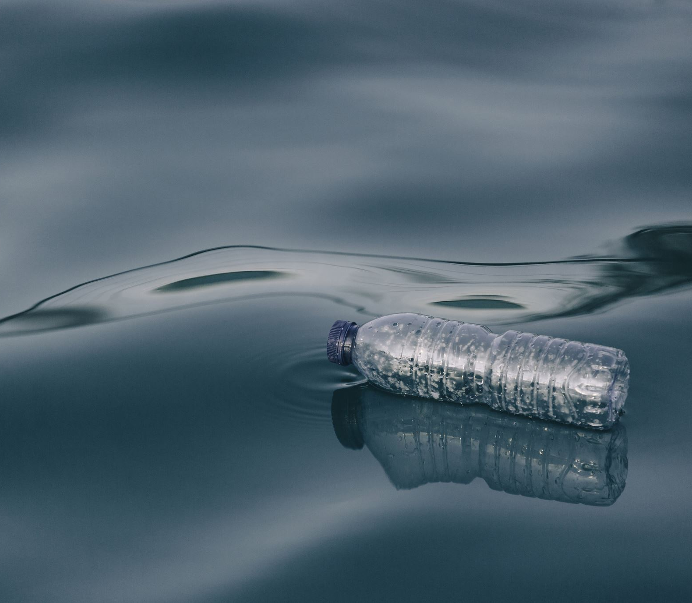
Caring for Our Environment
1. Key Initiatives
Energy Conservation
Using energy-efficient lighting, appliances, and renewable energy sources to reduce our carbon footprint.
Water Conservation
Low-flow fixtures, water recycling, and sustainable irrigation systems to save water.
Waste Reduction
Effective waste management through waste separation stations in hotel areas. These stations encourage recycling, reduce landfill waste, and align with our sustainability goals.
Supporting Biodiversity
Native plant landscaping to support local flora and fauna.
Partnerships with environmental groups to protect nearby ecosystems and wildlife.

Slide 11
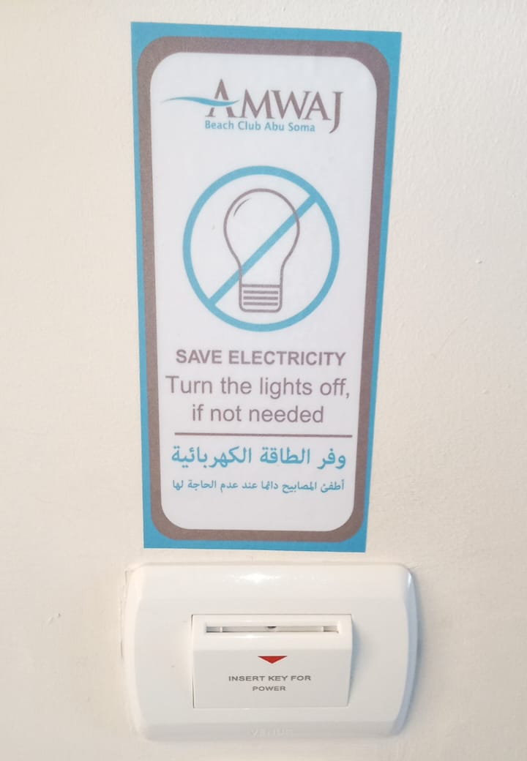
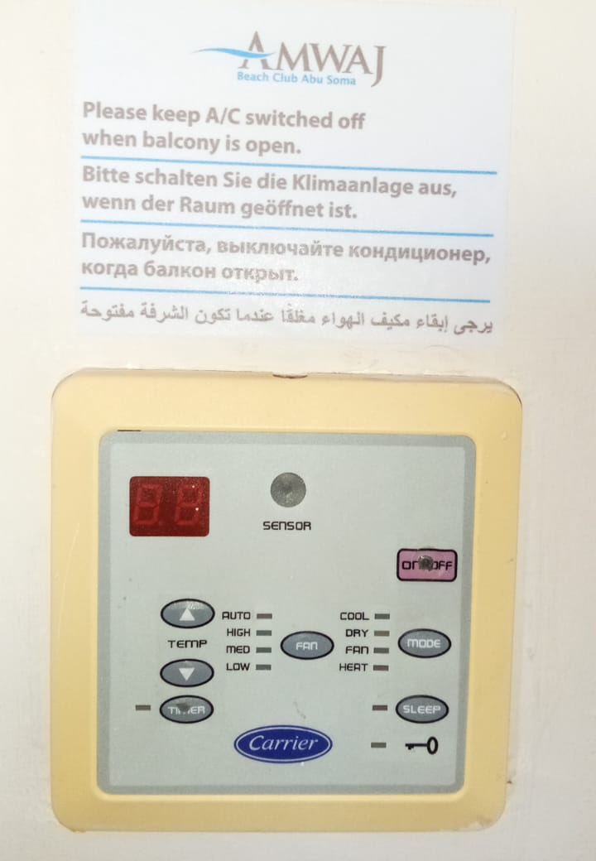
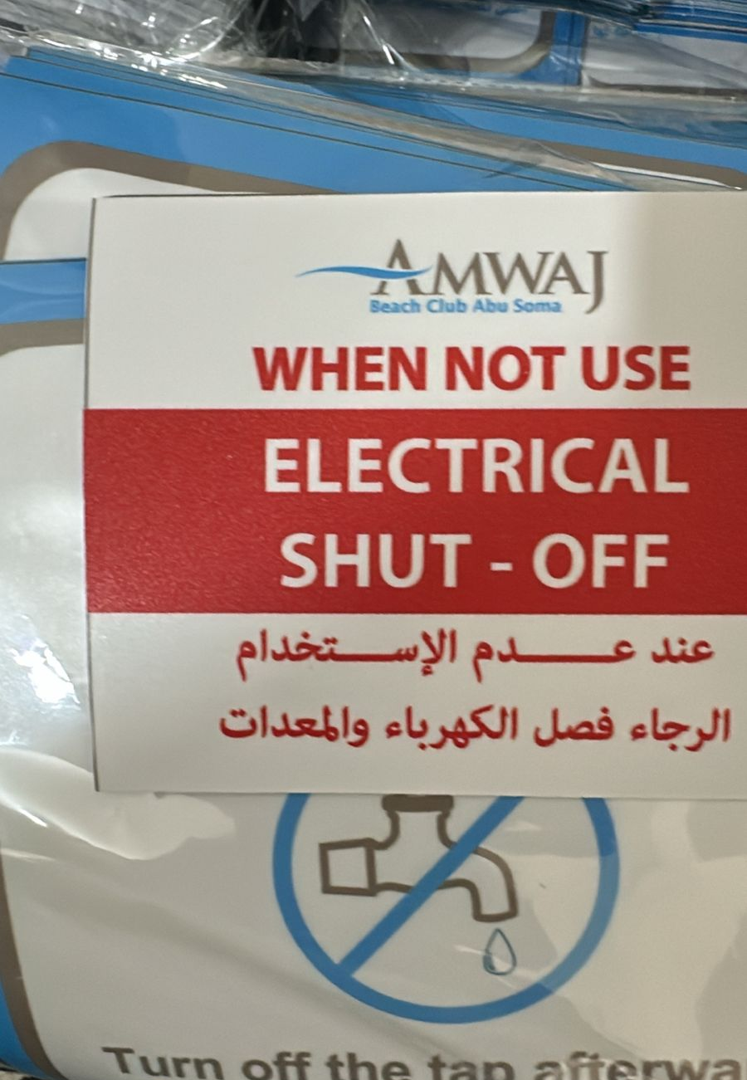
Resources saving

Slide 12
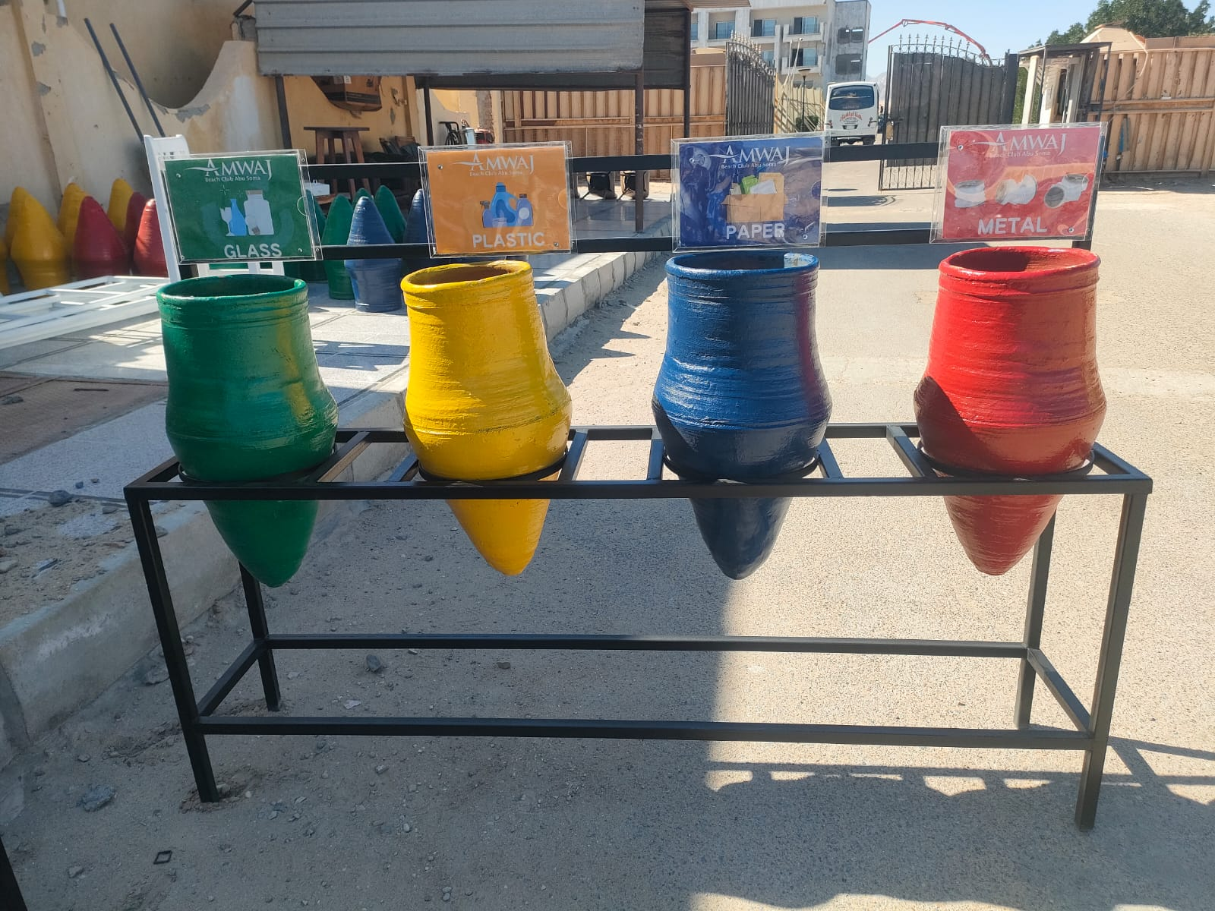
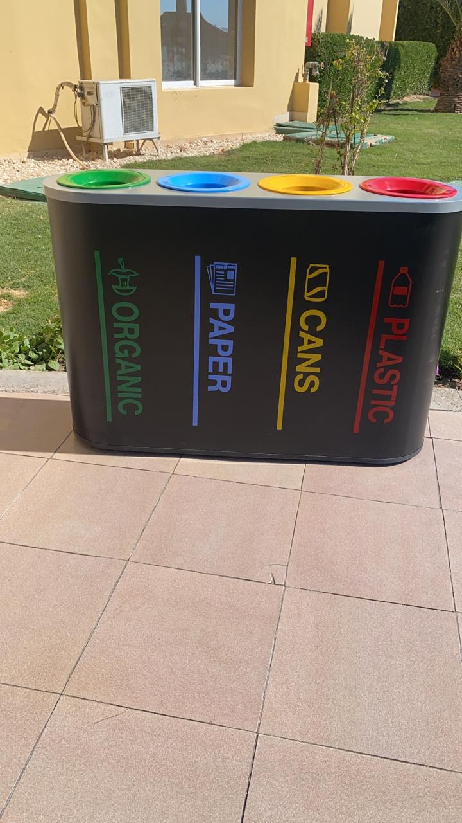
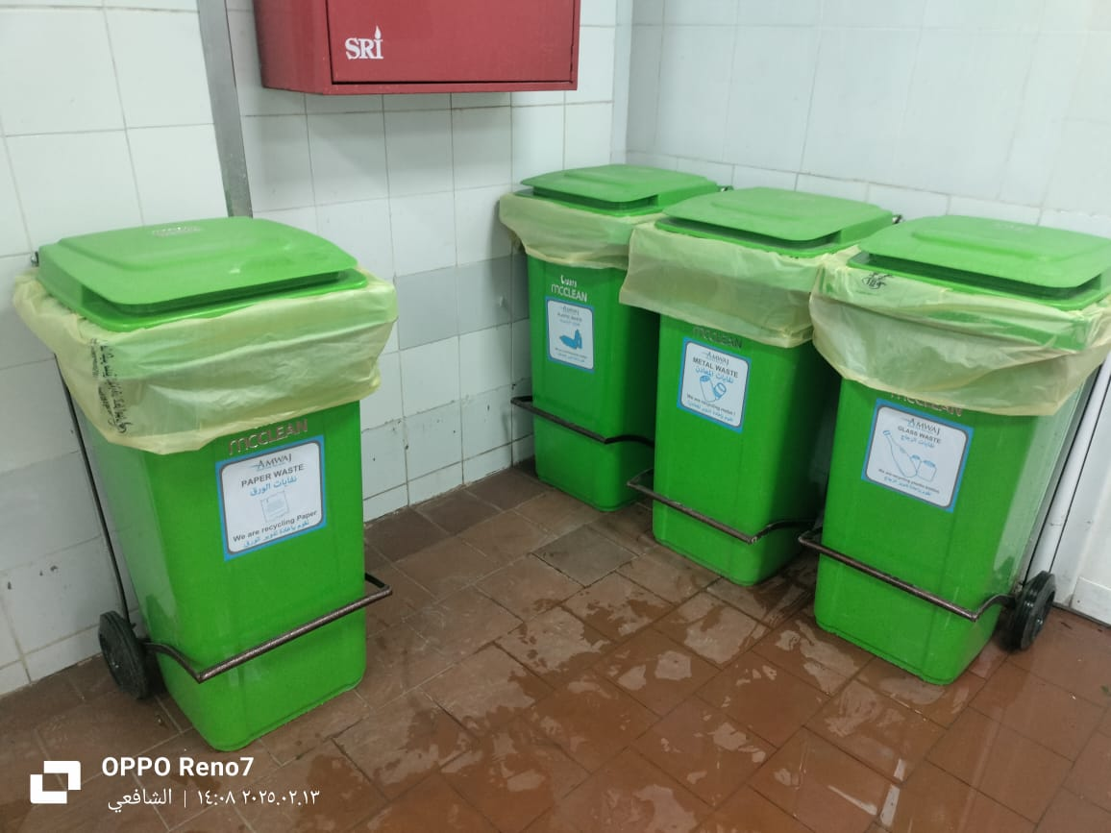
committed to effective waste management through waste separation stations in hotel areas. These stations encourage recycling, reduce landfill waste, and align with our sustainability goals. By sorting waste at the source, we minimize environmental impact and promote eco-friendly practices among guests and staff.
Waste management

Slide 13
Future Goals
Transition to Gas-Powered Kitchen Equipment Upgrade all kitchen equipment to gas-powered systems to improve energy efficiency and reduce reliance on electricity.
Eliminate Single-Use Plastic Bottles Replace disposable plastic bottles with BRITA water dispensing machines, promoting sustainable hydration and reducing waste.
Enhance AC Unit Efficiency Install shading structures around air conditioning units to reduce energy consumption and optimize cooling performance.
Minimize Food Waste Implement strategies to reduce food leftovers, improve sustainable dining practices, and enhance food waste management.
Optimize food procurement with accurate demand forecasting.
Improve kitchen operations through batch cooking, portion control, and waste monitoring.
Reduce Irrigation Water Usage Minimize water consumption by optimizing irrigation systems and reducing the need for water in landscaping.
Reduce Irrigation water Decrease the size of green areas on the property to further reduce water usage and maintenance needs.

